Slide 1

Recommender Systems: Personalized Content Discovery
Recommender systems play a crucial role in enhancing user experiences by providing tailored suggestions for content, products, and services. These systems utilize algorithms to analyze user data and preferences, offering personalized recommendations that aim to maximize engagement and satisfaction.

Slide 2

Introduction to Recommender Systems
1
Predictive Power
2
Personalized Experiences
Recommender systems leverage user data to predict preferences and provide personalized recommendations.
Tailored suggestions for products, content, or services based on user interactions.
3
Increased Engagement
Recommender systems promote user engagement by highlighting relevant content and items.

Slide 3
Collaborative Filtering: Harnessing User Preferences
User Similarity
Recommendation Generation
Popularity Bias
Identifies users with similar tastes and preferences.
Recommends items liked by similar users to the target user.
May favor popular items over niche or less-known items.

Slide 4

Content-Based Recommendations: Leveraging Item Attributes
Item Features
User Profiles
Analyzes attributes of items like genre, keywords, or descriptions.
Creates user profiles based on previously interacted content.
Matching Items
Recommends items similar to those the user has interacted with before.

Slide 5
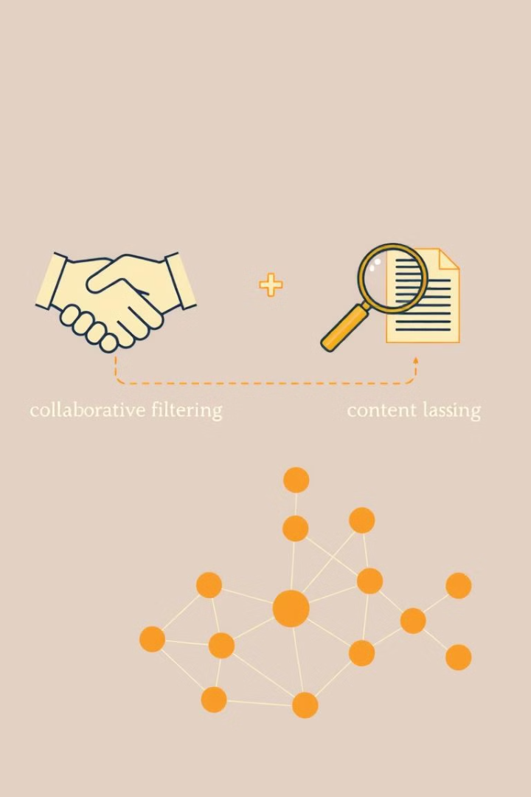



Hybrid Approaches: Combining Strengths
Content-Based
Leverages item attributes for personalized recommendations.
Collaborative Filtering
Analyzes user preferences and similarities.
Hybrid Approach
Combines both methods for a more comprehensive and accurate recommendation system.

Slide 6

Streaming Recommendations: A Netflix Case Study
1
User Interaction
Netflix monitors user interactions like watching, pausing, and rewinding.
2
Real-Time Analysis
Data is processed in real time to understand user preferences.
3
Dynamic Recommendations
Recommendations are adjusted based on real-time user activity.

Slide 7
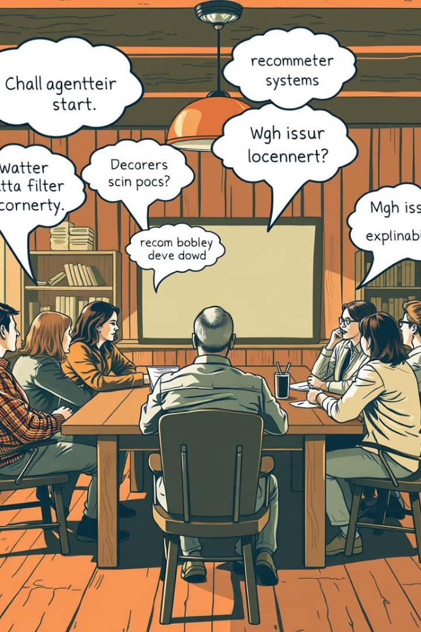
Challenges and Limitations in Recommender Systems
Cold Start Problem
Difficulty in recommending to new users or new items.
Data Sparsity
Limited user data may lead to inaccurate predictions.
Filter Bubbles
Recommending only similar content can restrict exposure to diverse options.

Slide 8





The Future of Personalized Recommendations
AI Integration
Context Awareness
Privacy Concerns
Diversity and Inclusion
More sophisticated AI algorithms for enhanced prediction.
Recommendations tailored to user context like location and time.
Addressing user privacy concerns related to data collection.
Promoting recommendations that represent a wider range of preferences.

